Slide 1
Final presentation
Nada Attar

Slide 2
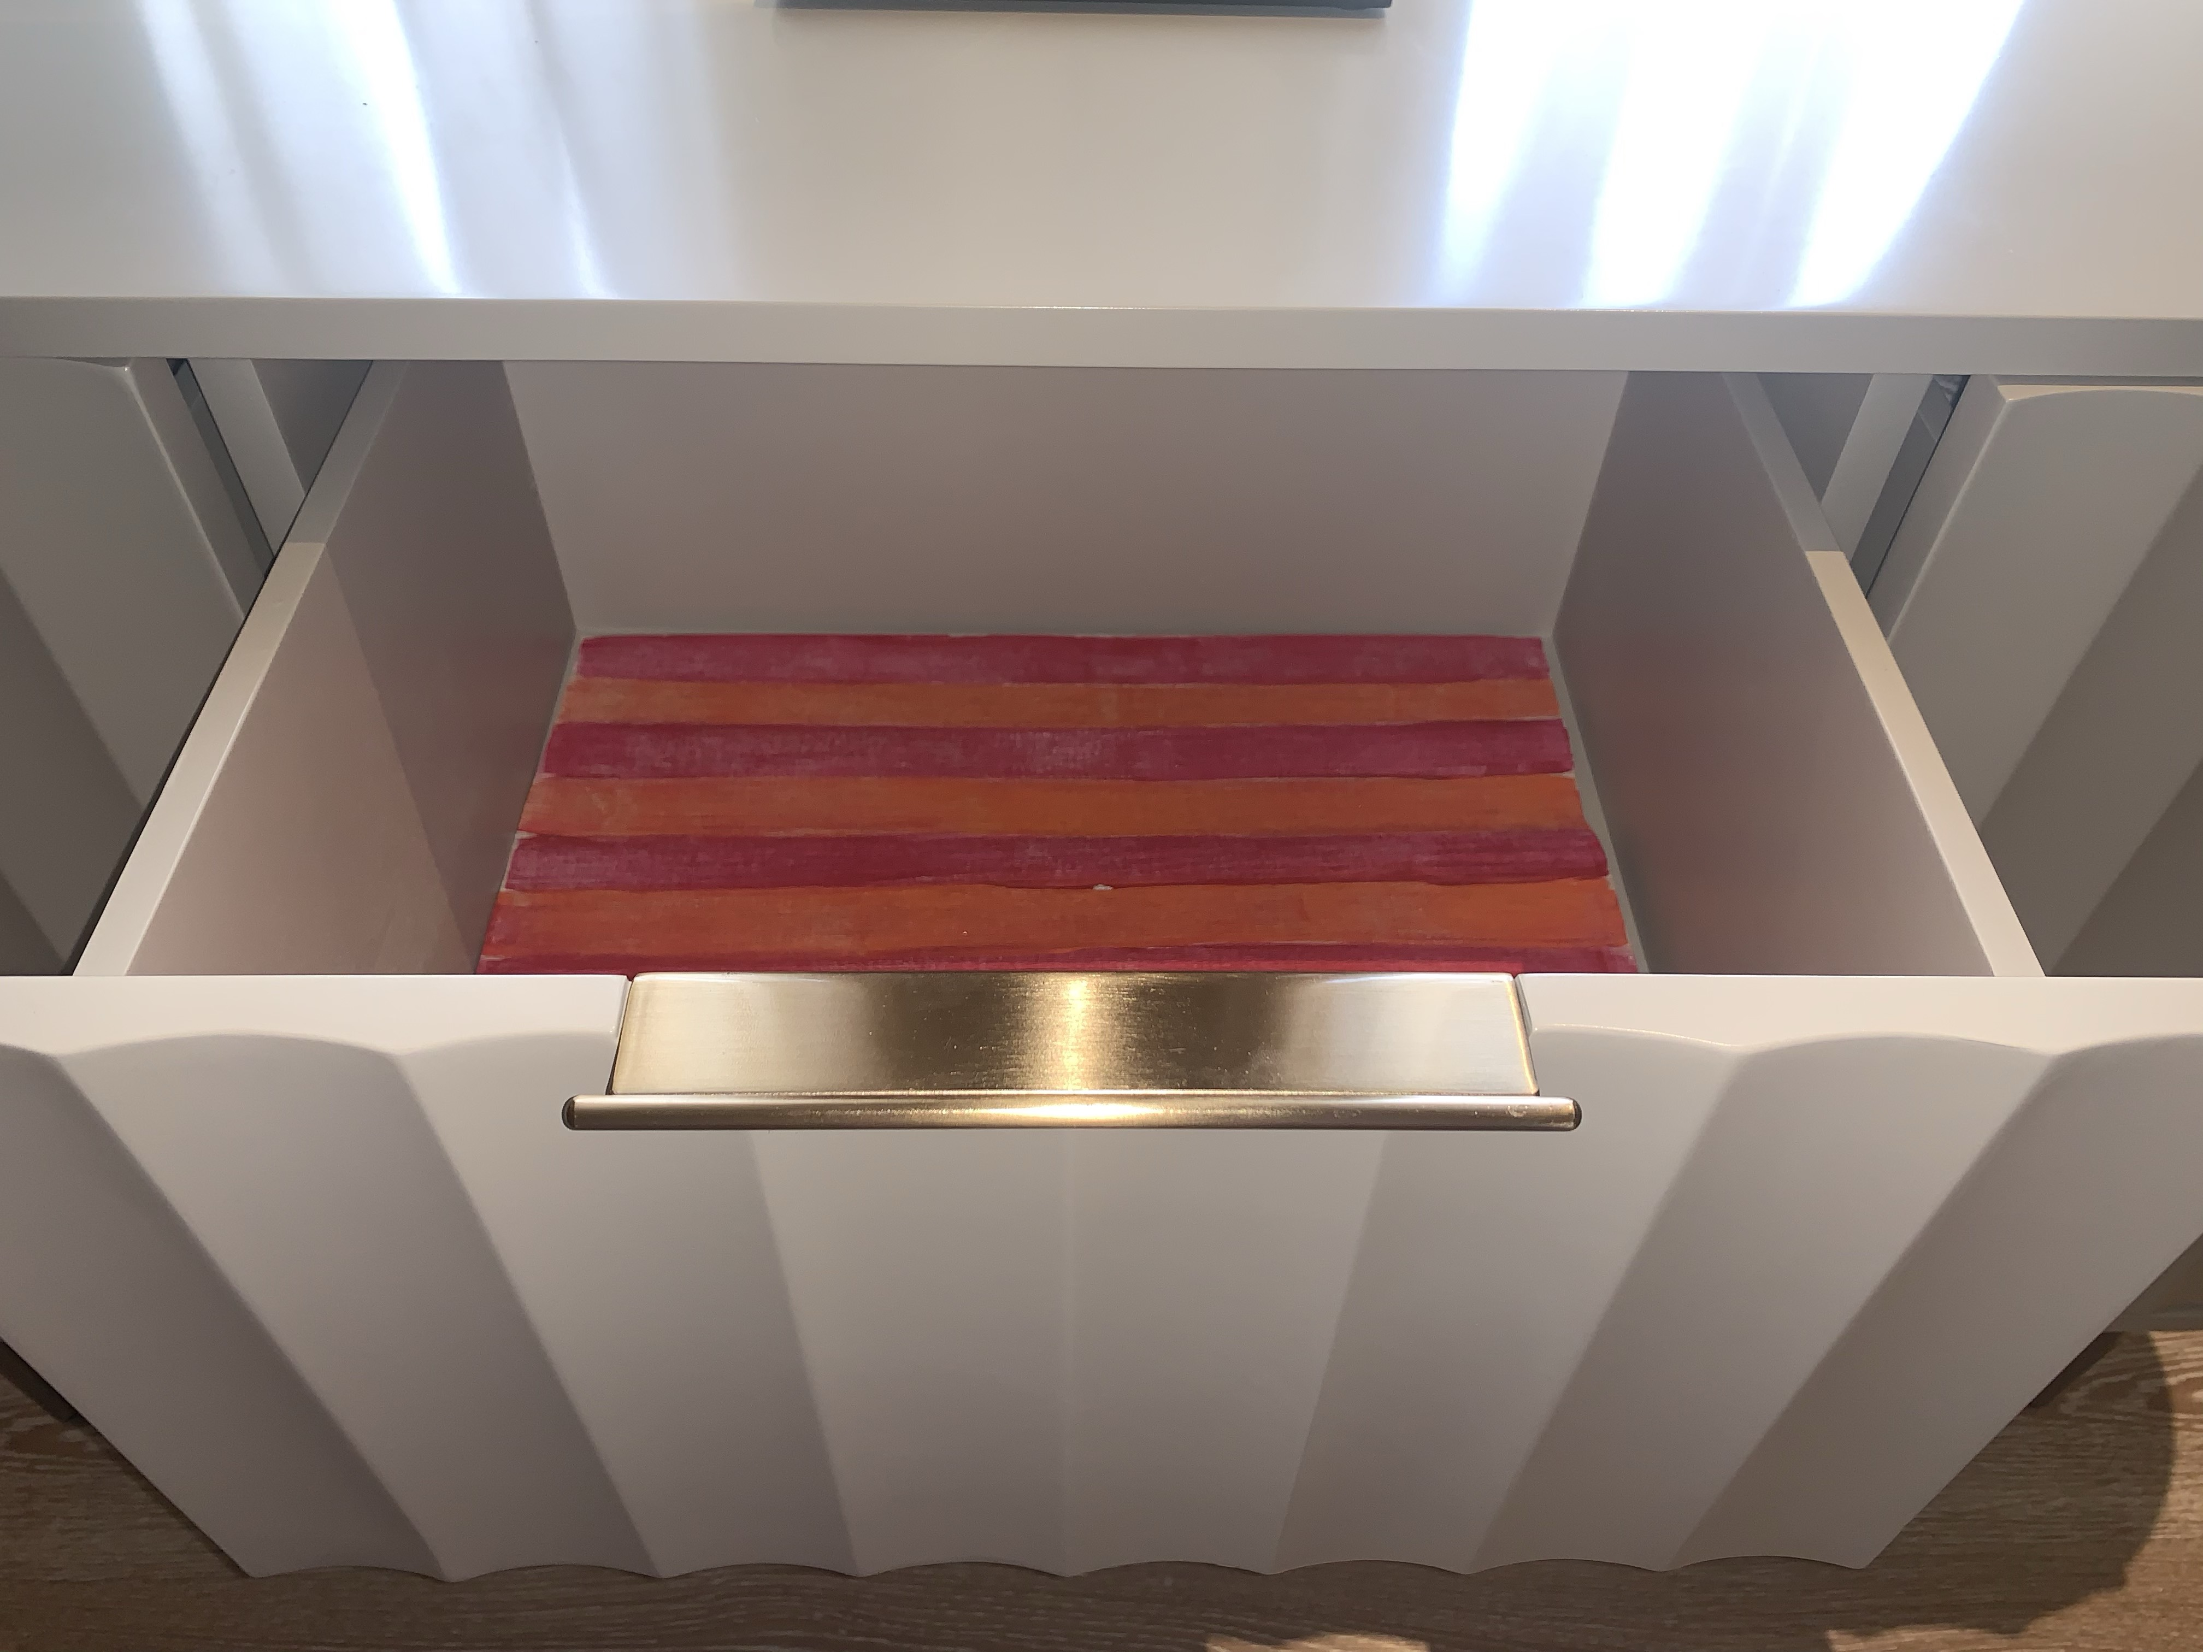
Drawer

Slide 3
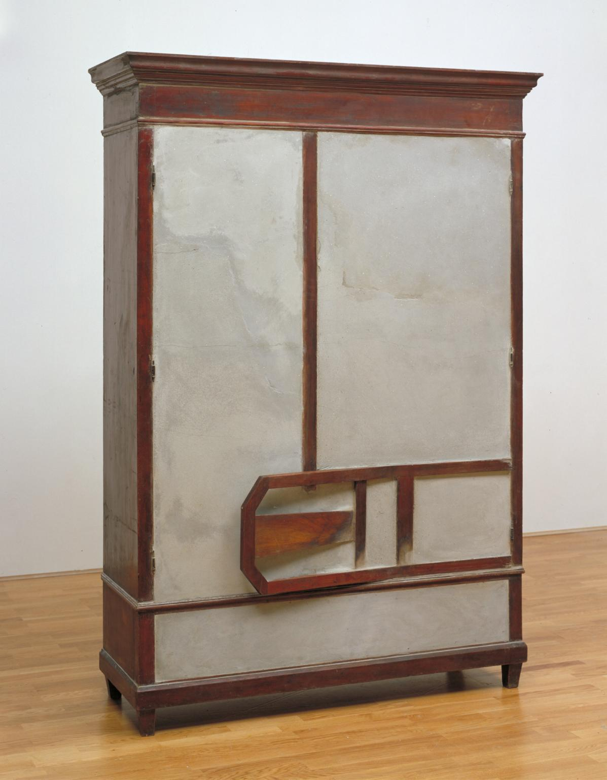
Untitled by Doris Salcedo
1998
Untitled is a sculpture combining two pieces of furniture with poured cement.
“I work with materials that are already charged with significance, with a meaning they have acquired in the practice of everyday life. Used materials are profoundly human; they all bespeak the presence of a human being: -salcado (Quoted in Basualdo, pp.21-3.)
In relation to the cement, they stand in for bodies; although as their openings are closed they are bodies that can no longer function; they are sealed and silenced in a manner that powerfully evokes death and entombment. As well as uncomfortably fusing two or more pieces of furniture, Salcedo’s Untitled series often incorporates clothing into the layer of concrete filling the openings in the cupboards, drawers and cabinets suggesting even more poignantly the remains of people who are no longer alive.

Slide 4
How are everyday objects political?
“Through designerly means and forms, adversarial design evokes and engages political issues.”
Tony Fry

Slide 5
Poetics of Space by Gaston Bachelard
“Wardrobes with their shelves, desks with their drawers, and chests with their false bottoms are veritable organs of the secret psychological life.“ Page 78
“A wardrobe’s inner space is also intimate space, space that is not open to just anybody.”

Slide 6
Doris Salcedo and Gaston Bachelard
“A wardrobe’s inner space is also intimate space, space that is not open to just anybody.”

Slide 7
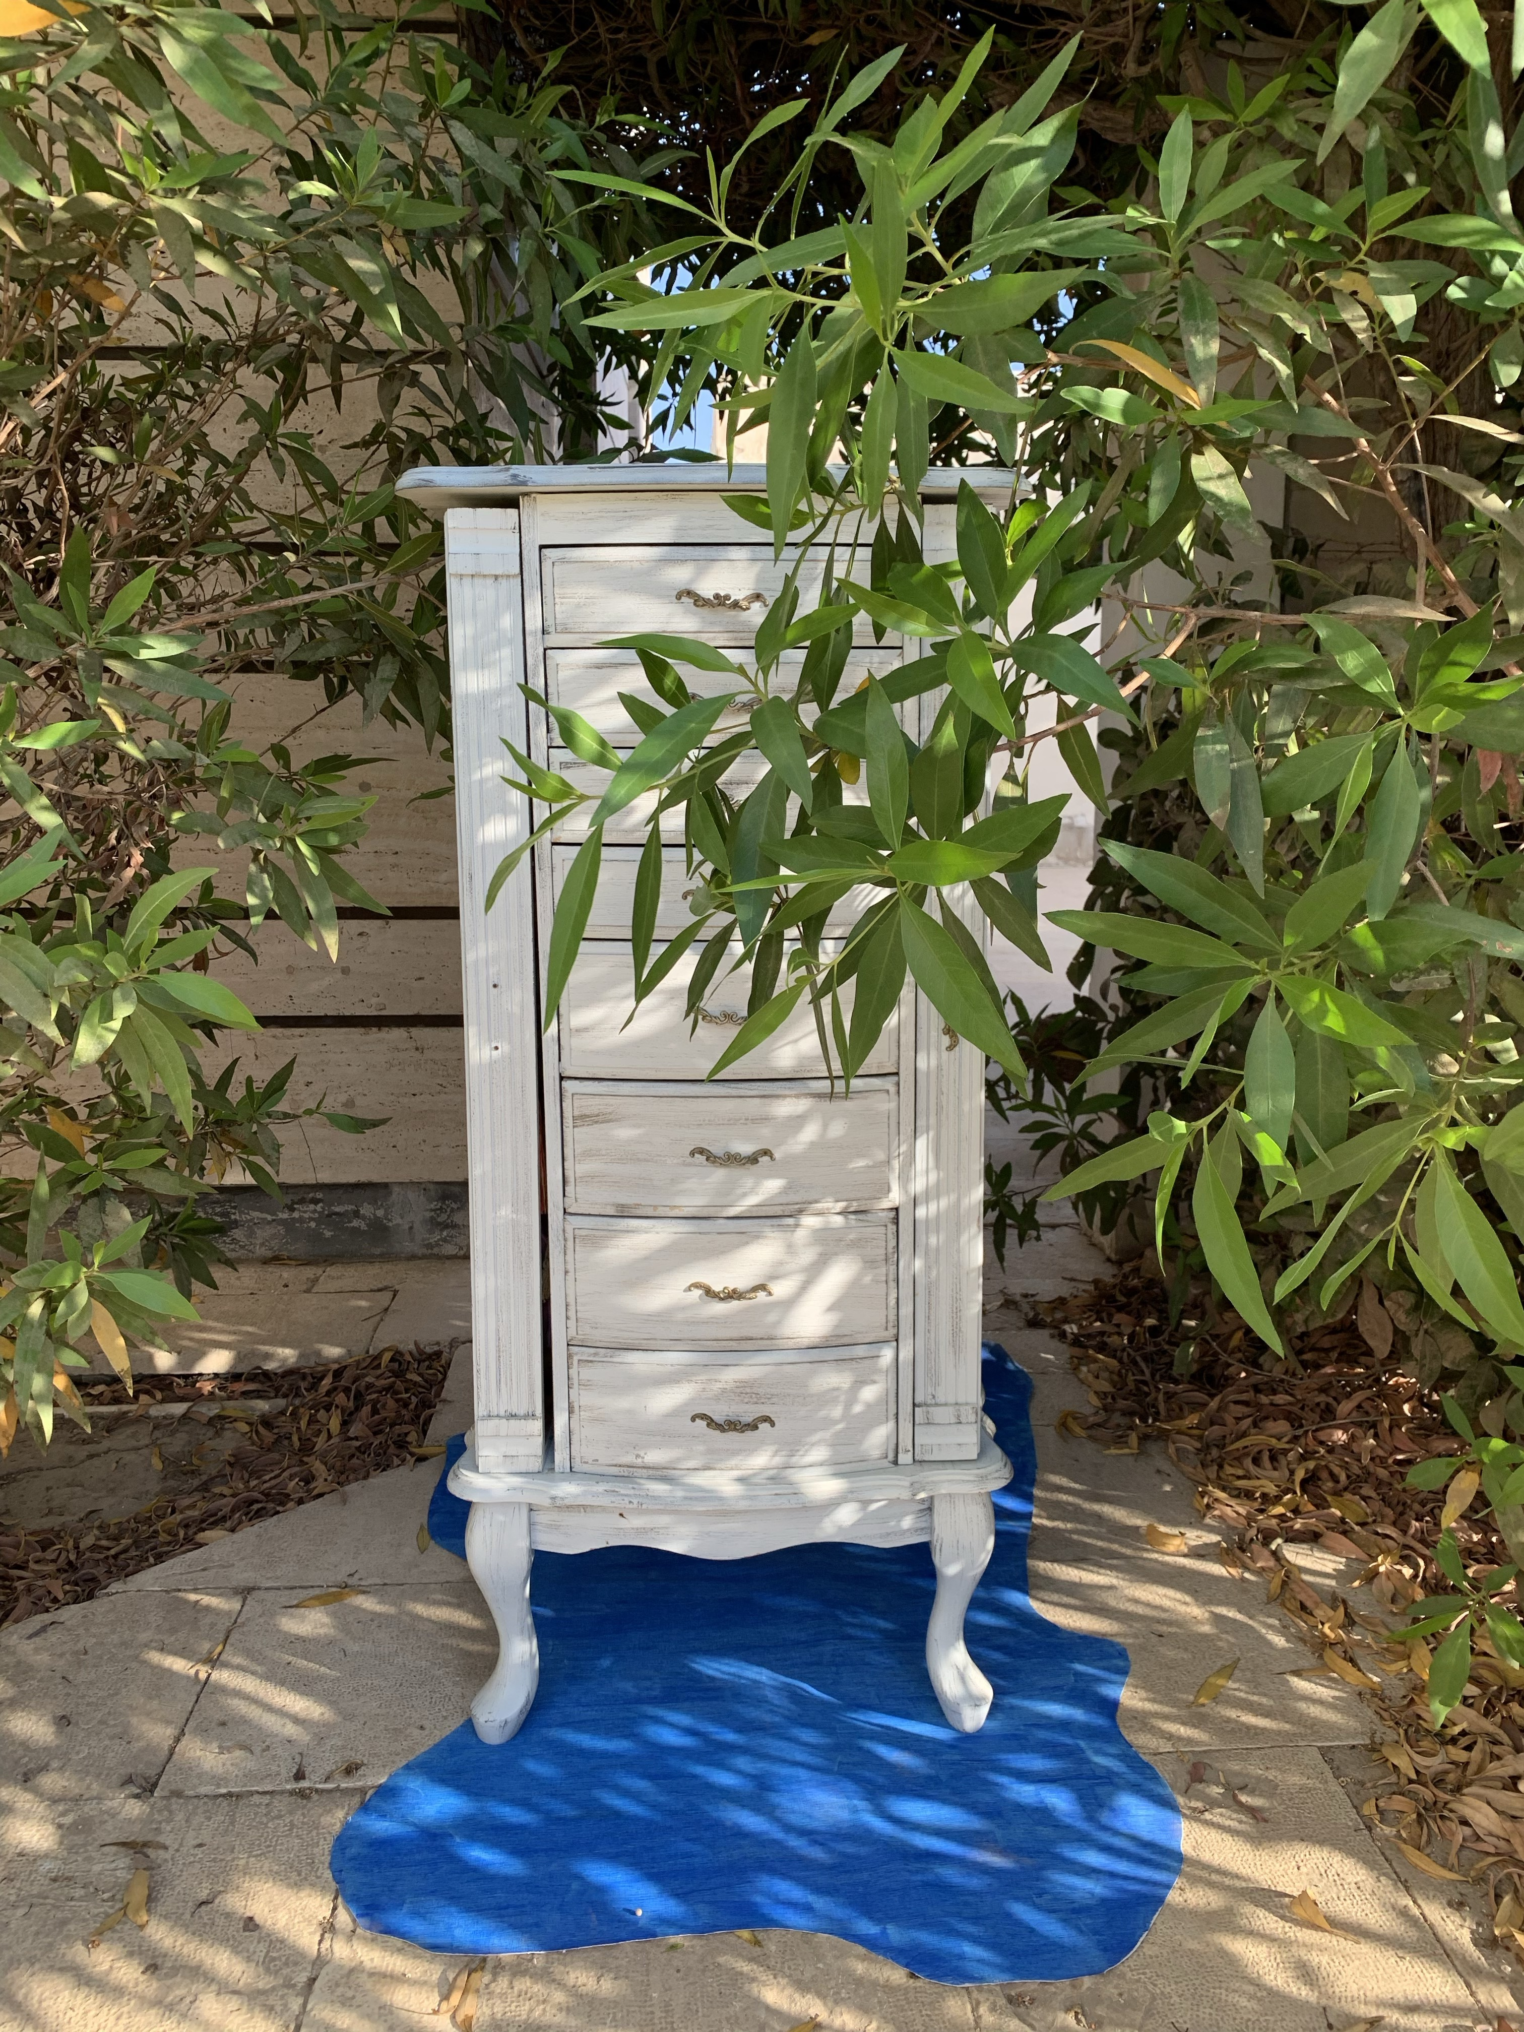
Cupboard

Slide 8
List of references
Camacho, J., 2018. How Design Is Politics.. [online] Medium. Available at: <https://medium.com/@j_camachor/how-design-is-politics-5418d9077df0> [Accessed 27 July 2020].
BACHELARD, G. (1969). The poetics of space. Boston, Beacon Press.
Manchester, E., 2007. ‘Untitled’, Doris Salcedo, 1998 | Tate. [online] Tate. Available at: <https://www.tate.org.uk/art/artworks/salcedo-untitled-t07524> [Accessed 13 August 2020].
OH, Y., 2018. From The Ornate To The Ethical: The Politics Of Everyday Objects. [online] Kadenze Blog. Available at: <https://blog.kadenze.com/arts-culture/from-the-ornate-to-the-ethical-the-politics-of-everyday-objects/> [Accessed 25 July 2020].

